Slide 1
CS2100 Tutorial #5
Prepared by Aaron Tan
Modified by Song Kai

Slide 2
add $8, $8, $16
Instruction
Memory
PC
Add
0
MUX
Instruction
4
1
Left Shift 2-bit
Add
Address
PCSrc
ALUcontrol
Inst [25:21]
5
$8
4
RR1
RD1
5
$16
R[$8]
is0?
MemWrite
Inst [20:16]
RR2
0
$8
Register
File
ALUSrc
ALU
opcode
31:26
rs
25:21
rt
20:16
rd
15:11
shamt
10:6
5
000000
01000
10000
01000
funct
5:0
WR
ALU
result
00000
100000
MUX
0
Address
R[$8]+R[$16]
RD2
MUX
1
WD
R[$16]
Data
Memory
MemToReg
Inst [15:11]
1
RegWrite
Read
Data
1
MUX
RegDst
Write
Data
Inst [15:0]
Sign Extend
0
MemRead

Slide 3
beq $16, $0, Else
Instruction
Memory
PC
Add
0
MUX
Instruction
4
1
Left Shift 2-bit
Add
Address
PCSrc
opcode
31:26
000100
ALUcontrol
rs
25:21
10000
Inst [25:21]
5
$16
4
RR1
RD1
5
$0
R[$16]
TRUE
MemWrite
Inst [20:16]
RR2
is0?
rt
20:16
00000
Register
File
ALU
0
5
WR
ALUSrc
MUX
0
ALU
result
Address
RD2
MUX
1
WD
R[$0]
Data
Memory
MemToReg
Inst [15:11]
1
immediate
10:6
RegWrite
Read
Data
1
MUX
0000000000000011
RegDst
Write
Data
Inst [15:0]
Sign Extend
0
MemRead
Notes:
beq don’t care about RegDst and MemToReg
beq performs subtraction in ALU

Slide 4
beq $16, $0, Else
Instruction
Memory
PC
Add
0
MUX
Instruction
4
1
Left Shift 2-bit
Add
Address
PCSrc
opcode
31:26
000100
ALUcontrol
rs
25:21
10000
Inst [25:21]
5
$16
4
RR1
RD1
5
$0
R[$16]
is0?
FALSE
MemWrite
rt
20:16
Inst [20:16]
RR2
00000
0
Register
File
ALUSrc
ALU
MUX
5
WR
ALU
result
0
MUX
Address
1
RD2
R[$0]
WD
Data
Memory
MemToReg
Inst [15:11]
1
immediate
10:6
RegWrite
Read
Data
1
MUX
0000000000000011
RegDst
Write
Data
Inst [15:0]
Sign Extend
0
MemRead

Slide 5
lw $8, 4($17)
Instruction
Memory
PC
Add
0
MUX
Instruction
4
1
Left Shift 2-bit
Add
Address
PCSrc
opcode
31:26
100011
ALUcontrol
rs
25:21
10001
Inst [25:21]
5
$17
4
RR1
RD1
5
R[$17]
is0?
MemWrite
rt
20:16
Inst [20:16]
RR2
01000
0
$8
Register
File
ALUSrc
ALU
MUX
5
WR
ALU
result
R[$17]+4
0
MUX
Address
1
M[R[$17]+4]
RD2
4
WD
Data
Memory
MemToReg
Inst [15:11]
1
immediate
10:6
RegWrite
Read
Data
1
MUX
0000000000000100
RegDst
Write
Data
M[R[$17]+4]
Inst [15:0]
Sign Extend
0
MemRead
Notes:
MemRead = 1, MemWRite = 0

Slide 6
sw $8, 0($17)
Instruction
Memory
PC
Add
0
MUX
Instruction
4
1
Left Shift 2-bit
Add
Address
PCSrc
opcode
31:26
101011
ALUcontrol
rs
25:21
10001
Inst [25:21]
5
$17
4
RR1
RD1
5
$8
R[$17]
is0?
MemWrite
rt
20:16
Inst [20:16]
RR2
01000
0
Register
File
ALUSrc
ALU
MUX
5
WR
ALU
result
R[$17]+0
0
MUX
Address
1
RD2
0
WD
Data
Memory
MemToReg
Inst [15:11]
1
immediate
10:6
RegWrite
Read
Data
1
MUX
0000000000000000
RegDst
R[$8]
Write
Data
Inst [15:0]
Sign Extend
0
MemRead
Notes:
RegDst and MemToReg don’t care
MemWrite = 1

Slide 7
Control Signal | Execution Stage | Purpose
RegDst | Decode/Operand Fetch | Select the destination register number
RegWrite | Decode/Operand Fetch RegWrite | Enable writing of register
ALUSrc | ALU | Select the 2nd operand for ALU
ALUControl | ALU | Select the operation to be performed
MemRead / MemWrite | Memory | Enable reading/writing of data memory
MemToReg | RegWrite | Select the result to be written back to register file
PCSrc | Memory/RegWrite | Select the next PC value
Notes:
The multiplexer waits for the control signal and will operate once the control signal is generated

Slide 8
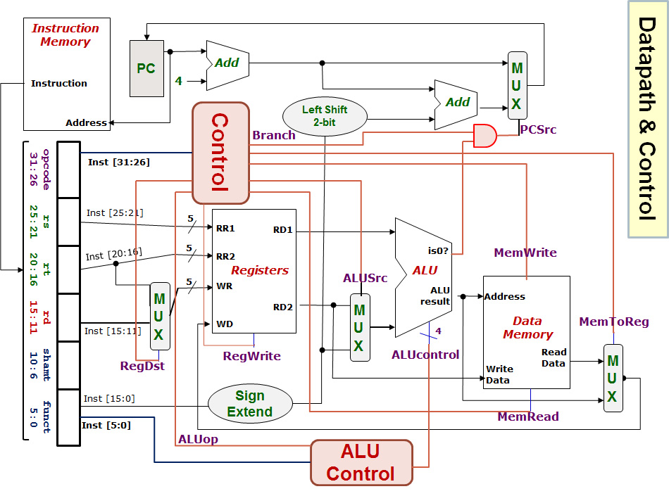
opcode
→ all control signals except for ALU control
→ 2-bit ALUop
0
1
funct + ALUop → ALU control
Opr1
0
1
0
1
Opr2
1
0

Slide 9
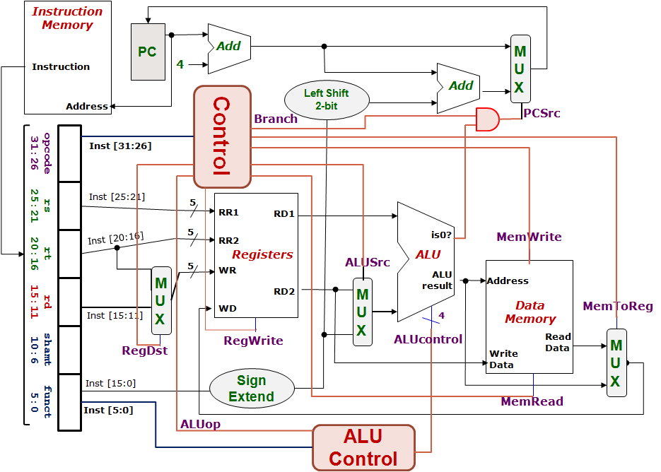
Control Design: Outputs
 | RegDst | ALUSrc | MemToReg | Reg Write | Mem Read | Mem Write | Branch | ALUop
 |  |  |  |  |  |  |  | op1 | op0
R-type
lw
sw
beq
1
0
0
1
0
0
0
1
0
0
1
1
1
1
0
0
0
0
X
1
X
0
0
1
0
0
0
X
0
X
0
0
0
1
0
1
0
1
0
1
0
1
1
0
Notes:
PCSrc is derived from Branch AND is0
RegDst and MemToReg are don’t care for sw and beq because their RegWrite is zero
The don’t care simplifies the expressions

Slide 10
Generating ALUControl Signal
Opcode | ALUop | Instruction Operation | Funct field | ALU action | ALU control
lw |  | load word |  | add
sw |  | store word |  | add
beq |  | branch equal |  | subtract
R-type |  | add |  | add
R-type |  | subtract |  | subtract
R-type |  | AND |  | AND
R-type |  | OR |  | OR
R-type |  | set on less than |  | set on less than
Instruction Type | ALUop
lw / sw | 00
beq | 01
R-type | 10
00
xxxxxx
0010
00
xxxxxx
0010
01
xxxxxx
0110
10
10 0000
0010
10
10 0010
0110
10
10 0100
0000
10
10 0101
0001
10
10 1010
0111

Slide 11
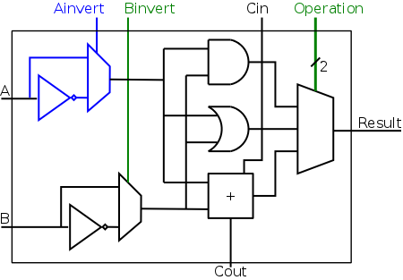
5. One Bit At A Time (Aha!)
Can you see how the ALUcontrol (4-bit) signal controls the ALU?
Note: implementation for slt not shown
ALUcontrol |  |  | Function
Ainvert | Binvert | Operation
0 | 0 | 00 | AND
0 | 0 | 01 | OR
0 | 0 | 10 | add
0 | 1 | 10 | subtract
0 | 1 | 11 | slt
1 | 1 | 00 | NOR
Notes:
Ainvert and Binvert determine if we pass A or A’, and B or B’ as the input
We have 32 such combinatorial circuits concatenated to form the full 32-bit ALU
When we do subtraction, cin = 1 is passed to the circuit of LSB.

Slide 12
lw $24, 0($15)
R[rt] = M[R[rs]+SignExtImm]
100011 01111 11000 0000000000000000
Registers File |  |  |  | ALU |  | Data Memory
RR1 | RR2 | WR | WD | Opr1 | Opr2 | Address | Write Data
Q1(i)
Red means the data is actually used.
Blue means the data is not used.
$15
$24
$24
MEM([$15]+0)
[$15]
0
[$15]+0
[$24]
Next PC value = PC + 4
0
1
RegDest
RegWrite
ALUSrc
MemRead
MemWrite
MemToReg
Branch
ALUop
ALUcontrol
0
Easy, just copy from tables in previous slides.
1
0
1
100011
1
01111
0
Opr1
1
11000
0
0
1
0
00000 00000 000000
0
1
00
Opr2
1
0010
1
0
1

Slide 13
beq $1, $3, 12
If (R[rs]==R[rt]) PC=PC+4+BrAddr
000100 00001 00011 0000000000001100
Registers File |  |  |  | ALU |  | Data Memory
RR1 | RR2 | WR | WD | Opr1 | Opr2 | Address | Write Data
Q1(ii)
$1
$3
$3 or $0
[$1]-[$3] or MEM([$1]-[$3])
or random
[$1]
[$3]
[$1] – [$3]
[$3]
0
1
Next PC value = PC + 4
or (PC+4) + (12×4)
RegDest
RegWrite
ALUSrc
MemRead
MemWrite
MemToReg
Branch
ALUop
ALUcontrol
X
0
1
0
000100
0
00001
0
Opr1
X
00011
0
0
1
1
00000 00000 001100
0
1
01
Opr2
X
0
0110
1
0
X
0

Slide 14
sub $25, $20, $5
R[rd] = R[rs] – R[rt]
000000 10100 00101 11001 00000 100010
Registers File |  |  |  | ALU |  | Data Memory
RR1 | RR2 | WR | WD | Opr1 | Opr2 | Address | Write Data
Q1(iii)
$20
$5
$25
[$20] – [$5]
[$20]
[$5]
[$20] – [$5]
[$5]
0
1
Next PC value = PC + 4
RegDest
RegWrite
ALUSrc
MemRead
MemWrite
MemToReg
Branch
ALUop
ALUcontrol
1
1
0
0
000000
0
10100
0
Opr1
0
00101
0
0
1
0
11001
0
1
10
Opr2
1
0110
00000
1
0
100010
0

Slide 15
SUB instruction
Inst-Mem (400)
Reg.File (200)
MUX (ALUSrc)
(30)
ALU
(120)
MUX (MToR)
(30)
Reg.File
(200)
Control (100)
Q2(a)
Not critical path
Inst-Mem
400ps
-------------
Adder
100ps
-------------
MUX
30ps
-------------
ALU
120ps
-------------
Reg-File
200ps
-------------
Data-Mem
350ps
-------------
Control/ALUControl
100ps
-------------
Lshft/signext/AND
20ps
400+200+30+120+30+200 = 980ps
0
1
0
1
0
1
0
1
1
0
Notes:
The multiplexer for RegDst does not count because we only use WR at a later stage, Register Files can work as long as RR1 and RR2 are received.

Slide 16
LW instruction
Inst-Mem (400)
Reg.File (200)
ALU
(120)
DataMem
(350)
MUX (MToR)
(30)
Reg.File
(200)
Control (100)
Q2(b)
Not critical path
Inst-Mem
400ps
-------------
Adder
100ps
-------------
MUX
30ps
-------------
ALU
120ps
-------------
Reg-File
200ps
-------------
Data-Mem
350ps
-------------
Control/ALUControl
100ps
-------------
Lshft/signext/AND
20ps
400+200+120+350+30+200 = 1300ps
0
1
0
1
0
1
1
0
Why is MUX (ALUSrc) not included this time?
Notes:
When processing the Register Files, the immediate has already gone through the multiplexer (ALUSrc) to reach ALU.

Slide 17
BEQ instruction
Inst-Mem (400)
Reg.File (200)
MUX (ALUSrc)
(30)
ALU
(120)
AND
(20)
MUX (PCSrc)
(30)
Control (100)
Q2(c)
Not critical path
Inst-Mem
400ps
-------------
Adder
100ps
-------------
MUX
30ps
-------------
ALU
120ps
-------------
Reg-File
200ps
-------------
Data-Mem
350ps
-------------
Control/ALUControl
100ps
-------------
Lshft/signext/AND
20ps
400+200+30+120+20+30 = 800ps
0
1
How about the green path: PC → Adder → MUX (PCSrc)?
How about the purple path: Inst.Mem → SignExt → LeftShift → Adder → MUX(PCSrc)?
0
1
0
1
1
0

Slide 18
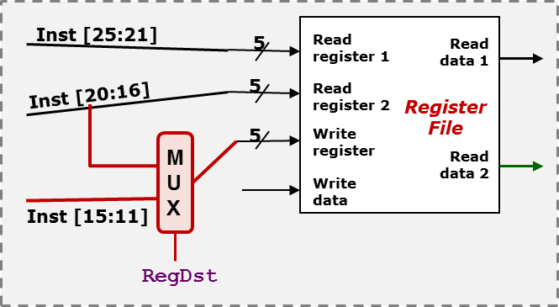

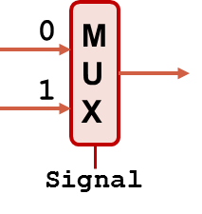
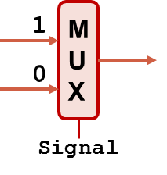
Q3(a)
add instruction
(i) One example where the incorrect processor still gives the right execution result.
Many possible answers.
Make RT = RD.
RegDst = 1
Example: add $t0, $t1, $t0
(ii) One example where the incorrect processor gives the wrong execution result.
Example: add $t0, $t1, $t2
$t2 instead of $t0 is picked as write register.
Correct
Wrong!
R[rd] = R[rs] + R[rt]
opcode
rs
rt
rd
shamt
funct

Slide 19
Q3(b)
lw instruction
(i) One example where the incorrect processor still gives the right execution result.
Make the first 5 bits of immediate value the same as the register number of RT.
RegDst = 0
Example: lw $4, 8192($t0)
8192 = 0x2000
0 | 0 | 1 | 0 | 0 | 0 | 0 | 0 | 0 | 0 | 0 | 0 | 0 | 0 | 0 | 0
$4
(ii) One example where the incorrect processor gives the wrong execution result.
Correct
Wrong!
R[rt] = M[R[rs] + SignExtImm]
Anything other than (i).
opcode
rs
rt
immed
Notes:
Instead of pssing in rt, we pass the 5 most significant bit in to write register

Slide 20
Q3(b)
beq instruction
(i) One example where the incorrect processor still gives the right execution result.
Anything will work, since error has no impact on branch instructions.
RegDst = X
(ii) One example where the incorrect processor gives the wrong execution result.
None.
Correct
Wrong!

Slide 21
Assignment 1 Marking Feedback
Accurate to 3 digits in the fraction part.
Get the 4th fractional digit to determine whether to round up the 3rd
Check if the 4th fractional digit >= base / 2
0.3705₁₀ ≈ 0.5ED9₁₆ ≈ 0.5EE₁₆
Underflow / overflow
They refer specifically to calculations
Labels are case-sensitive
j Exit does not jump to label exit.
Careless Mistakes :(
1111 1111.011 → 111 1111.011
$t4, $t5 → $4, $5
Incorrect mapping to rs, rt and rd

Slide 22
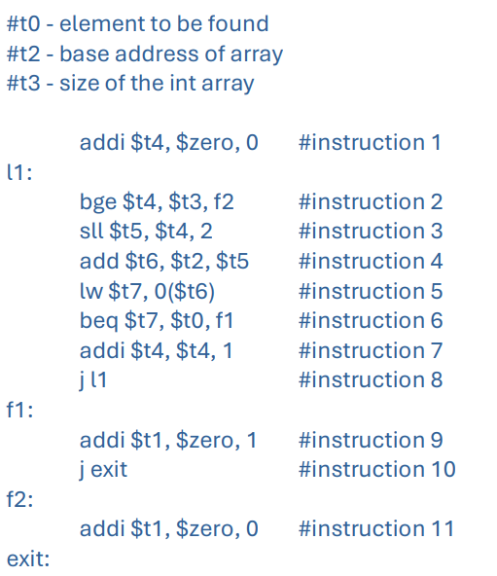
Assignment 1 Marking Feedback
Initialize $t1 to be zero before the loop.
At branch f1, increment $t1 and jump to l1.
At branch f1, we also need to increment $t4
Alternatively, swap instructions 6 and 7.
Alternatively, add a label before instruction 7 and let f1 jump to the label.
Make bge jump to exit.
Alternatively, remove instruction 11 and keep f2
Alternatively, use another register e.g. $t8 as the counter.

Slide 23
Captured on 2 Mar
Notes:
70% of you are full marks or close to full marks
10 mark → 1%

Slide 24
0
1
Opr1
0
1
0
1
Opr2
1
0
Notes:
We have special files to hold values until they are used

Slide 25
CS2100 Tutorial #5
Prepared by Aaron Tan
Modified by Song Kai

